Slide 1

Web scraping to gain company insights
13/06/2024

Slide 2
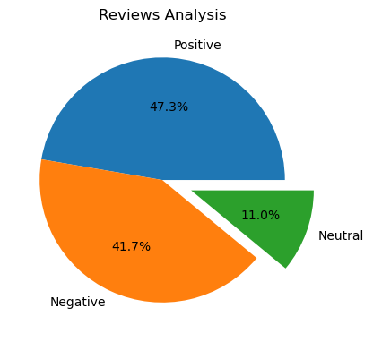
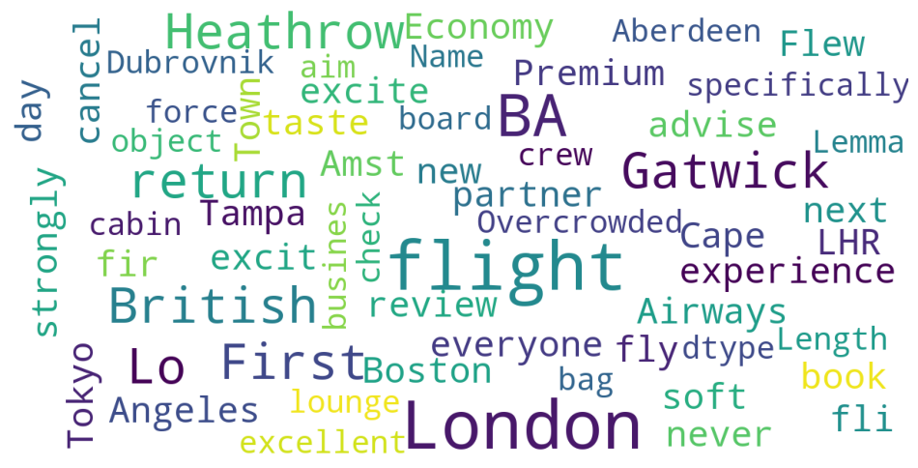
INSIGHTS FROM CUSTOMER REVIEWS
From cleaning 1000 reviews given by the customers, we obtained
Positive Reviews - 473
Negative Reviews - 417
Neutral Reviews – 110
Word cloud of keywords used in reviews

